Slide 1
Chapter 1
The Green Plant

Slide 2
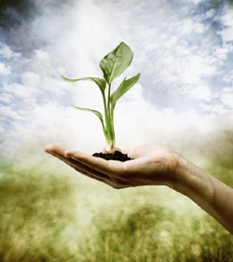
Green Plants produce and recycle the oxygen on which animal life depends.
Plants of the world include a rich array that may be either macroscopic or microscopic.
A classification system is an attempt to arrange current knowledge into a tidy system
Notes:
Microscopic aided eye
Macroscopic unaided eye
Taxonomy – latin lanuage

Slide 4
The current system for the scientific classification of plants are natural systems based on the genetic and evolutionary relationships among plants.
Each plant fits into the classification system in a unique way, based on the specific combinations of characteristics.
Notes:
Monocot or dicot
Flowering v non flowering
Taproot v fiborous root system

Slide 5
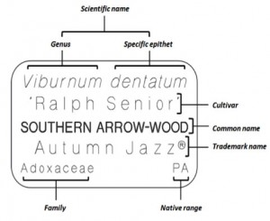
Cultivar is an intentionally cultivated variety whose continuance is due primarily to propagation by horticulturists.
Notes:
Cultivars are produced by careful breeding and selection for flower color and form.
Forma usually designates a group with a noticeable morphological deviation

Slide 6
Forma includes a group of plants within a species that are not truly a part of the natural classification system.
An appreciation of the diversity and complex relationships of the plant kingdom and the plant-like kingdom is essential to a successful career in ornamental horticulture.
Notes:
Forma usually designates a group with a noticeable morphological deviation

Slide 7
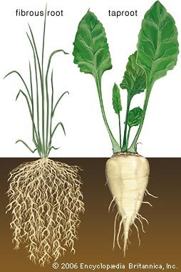
Roots are the below-ground portion of the plant.
Fibrous roots is a network of roots reaching out horizontally and vertically through the soil.
Tap root is one central root which grows larger and more dominant than the others.
Notes:
Examples of fiborous roots;
Fibrous roots have many branched roots. Examples of fibrous root plants are most grasses, marigolds, beans, peas, most cactuses, tomatoes, peppers.
Examples of taproot:
Taproot systems have a stout main root with a limited number of side-branching roots. Plants with taproots: nut trees, carrots, parsley, radishes, parsnips, dandelions, cabbages.

Slide 8
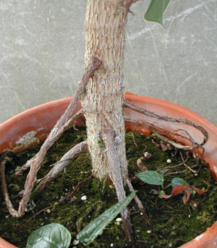
The principle function of the root is to absorb H2O and mineral nutrients from the soil.
Adventitious roots are specialized roots which develop from stems in some plants and from leaves and cut stems from others.
Notes:
adventitious roots makes it possible to vegetatively propagate many plants from stem or leaf cuttings.
African violet
Geranium
Poinsettia
impatiens

Slide 9
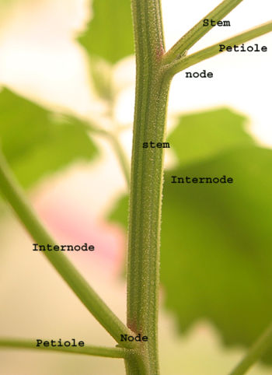
Stems are the central axis of plants.
The principle function of a stem is to conduct H2O and minerals absorbed by the roots to the leaves and
other above-ground plant
parts,
and to conduct food
materials produced in the
leaves to the roots and other
plant parts.

Slide 10
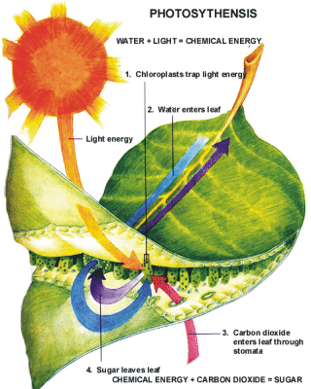
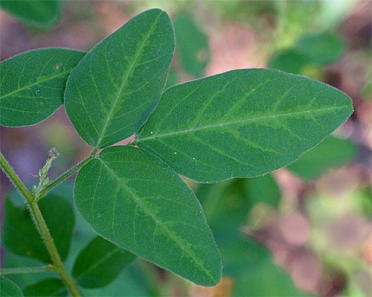
Leaves are appendages of the stem and are the major food manufacturers of the plant.
Photosynthesis is when plants use the energy in light to convert carbon dioxide and water into food and
oxygen.

Slide 11
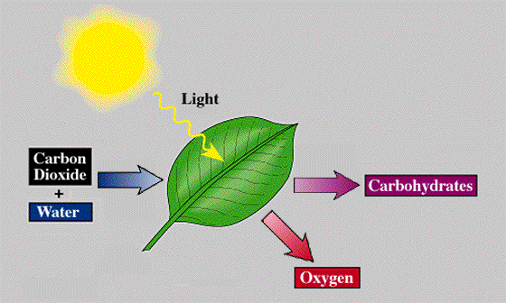
Overview of Photosynthesis
Photosynthesis in a nutshell:
Plants absorb light and use it to separate hydrogen from a water molecule.
The oxygen that remains is released as O₂.
The hydrogen from water is used to turn ATP Synthase so that it can make ATP.
ATP powers the process that creates a glucose molecule.
Photosynthesis equation: 6 CO₂ + 6 H₂O = C₆H₁₂O₆ + 6 O₂
Plants absorb H₂O and CO₂.
Plants produce glucose (C₆H₁₂O₆) and release O₂
Source: phschool.com
Notes:
high-energy molecule used for energy storage by organisms

Slide 12
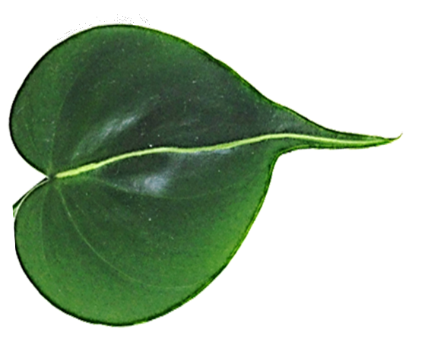
Photosynthesis in a nutshell…
CO₂
H⁺
O
H⁺
Glucose
H₂O
●Sunlight is used to split water
into H+ and oxygen.
● H+ powers ATP Synthase.
● ATP powers the production of
glucose from H+ and CO₂.

Slide 13
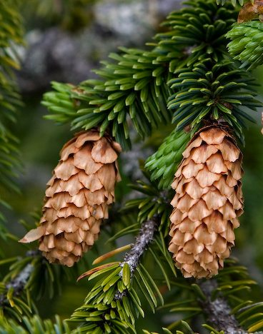
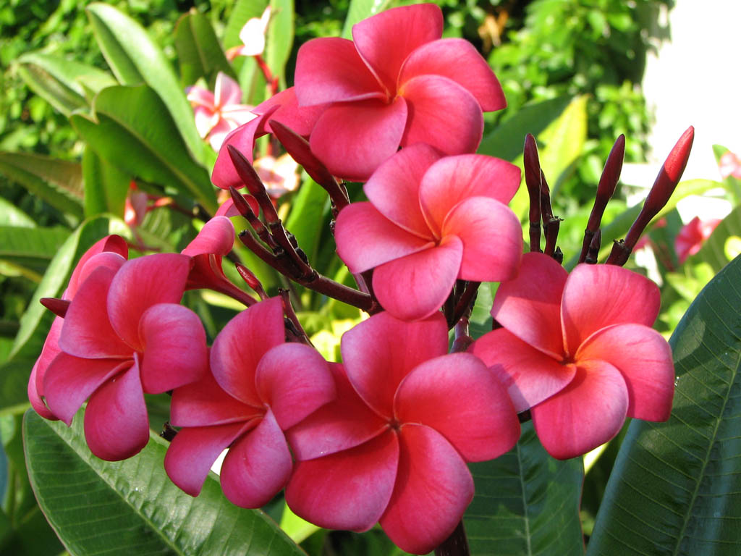
Cones are the reproductive structures of the conifers such as…
Flowers are reproductive structures that produce seeds enclosed in fruit.
Notes:
Conifirs: pines, spruces, and firs.

Slide 14
Flower Types

Slide 15
A complete flower is one that possesses all the floral organs, sepal, petals, stamens, pistils.
An incomplete flower lacks one or more of the floral organs.
A perfect flower has both stamens (male reproductive organs) and pistils (female reproductive organs).
An imperfect flower lacks one or the other.

Slide 16
If both pistillate and staminate flowers occur on the same plant it is said to be monoecious.
If two imperfect flowers occur on separate plants, the plants are termed dioecious.
A cluster of flowers is called its inflorescence.

Slide 17
Plant Structure

Slide 18
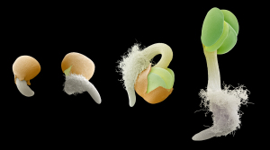
All living organisms except viruses have the cell as their basic structural unit.
Large groups of cells carrying on the same function are termed tissues.
Notes:
Plants grow from seeds to maturity by the enlargement of existing cells and the production of new ones.

Slide 19
Groups of tissues make up the organs of plants.
The cell wall is the foremost distinction between plant and animal cells
As cells age, they acquire deposits of lignin (complex polymers) within the carbohydrate matrix.
Notes:
, since animal cells lack walls.
Ligins:
form important structural materials in the support tissues of vascular plants and some algae.
formation of cell walls, especially in wood and bark, because they lend rigidity and do not rot easily.

Slide 20
The protoplast is a living matter of the cell.
The nucleus is a vessel in cell that contains the chromosomes, the nucleolus, and the nucleoplasm.
The chloroplast contains chlorophyll pigment which is vital to photsynthesis.
Cytoplasm is all the living material in the cell other than the nucleus.

Slide 21
The vacuole is a cavity within the cytoplasm.
Cell sap is salts, pigments, and organic materials in the vacuole.
The plasma membrane surrounds the protoplast like a thin plastic bag separating it from the cell wall.
Cytoplasmic strands connect the protoplasts of adjacent cells.
Mitochondria specialized regions of the plant.

Slide 22
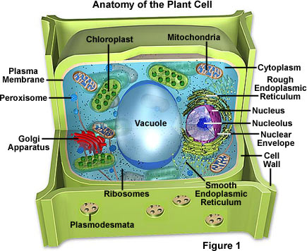

Slide 23
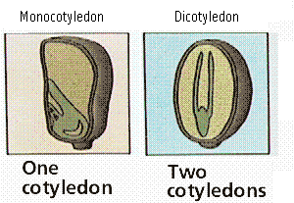
Meristematic cells remain simple and primarily divide and create new cells, permitting the plant to grow.
Vascular bundles are the conducting tissue of a plant. It is composed of xylem and the phloem.
Monocotyledon is plants that have one cotyledon.
Dicotyledon is plants that have two cotyledons.

Slide 24
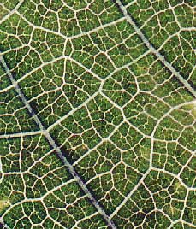
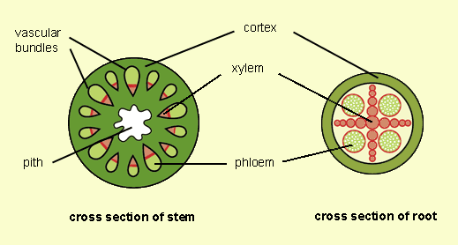
The cambium tissue produces the xylem and phloem.
The pattern of the veins in the leaves termed venation.
Notes:
Xylem: can only move up – transports water and minerals root to aerial parts of the plan
Phleom: can move up or down – transports food and nutrients such as sugars and amino acids from leaves to storage organs.

Slide 25
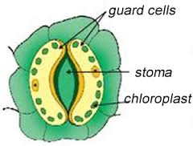
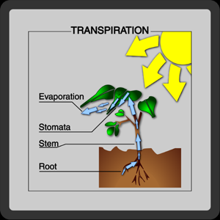
Stomates are pores through which gaseous exchange between the air outside the plant and the inter-cellular spaces inside the plant occur.
Transpiration is when the plant loses water vapor through the stomata when they are open.
Notes:
any of the minute pores in the epidermis of the leaf or stem of a plant

Slide 26
In a majority of higher plants, including the ornamentals, chlorophyll is the pigment in greatest abundance.
Xanthophyll is bright yellow.
Carotene is orange.
Anthocyanins is red.
Notes:
Xanthophyll – a yellow or brown carotenoid plant pigment that causes the autumn colors of leaves.
Carotene – orange b vitamins
Anthcoyanins- pigments contribute to darker colors

Slide 27
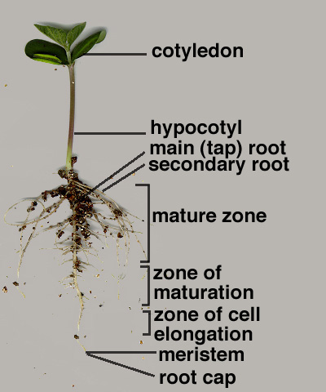
The root elongates in the region of the apical meristem.
The apical meristem is protected by the root cap as the root presses through the soil.

Slide 28
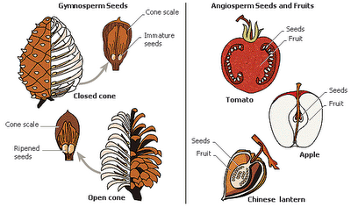
The gymnosperms and angiosperms are seed-bearing plants. A seed is a miniature plant.
A miniature plant is termed an embryo.
Monocots produce one cotyledon, and dicots produce two cotyledons.

Slide 29
Monocots vs Dicots

Slide 30
Monocots
Leaves have parallel Veins
Fibrous Roots
Flower parts in 3’s
Seed has one part (cotyledon)
Vascular bundles are scattered

Slide 31
Dicots
Leaves have branched Veins
Tap Roots
Flower parts in 4’s & 5’s
Seed has two parts (cotyledons)
Vascular bundles are in a ring

Slide 33
Cotyledon
Cotyledon: an embryonic leaf in seed-bearing plants, one or more of which are the first leaves to appear from a germinating seed.
https://www.youtube.com/watch?v=gI2RxzAT-ww

Slide 34
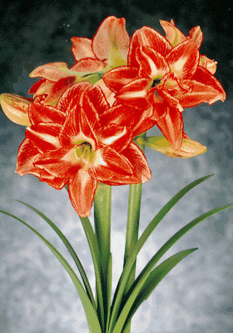
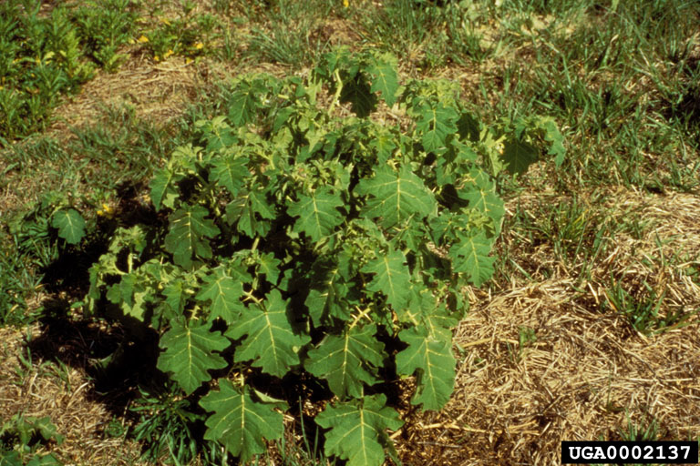
Juvenility is a state of vegetative growth during which a plant cannot flower.
Maturity is the state of growth during which the plant becomes capable of flowering.
A green plant is comparable to a machine that operates nonstop.

Slide 35
Physiological Processes of Plants

Slide 36
The three physiological processes that stand out are photosynthesis, respiration, and transpiration.
The rate of photosynthesis varies with the light intensity, temperature, and concentration of carbon dioxide in the plant’s atmosphere.

Slide 37
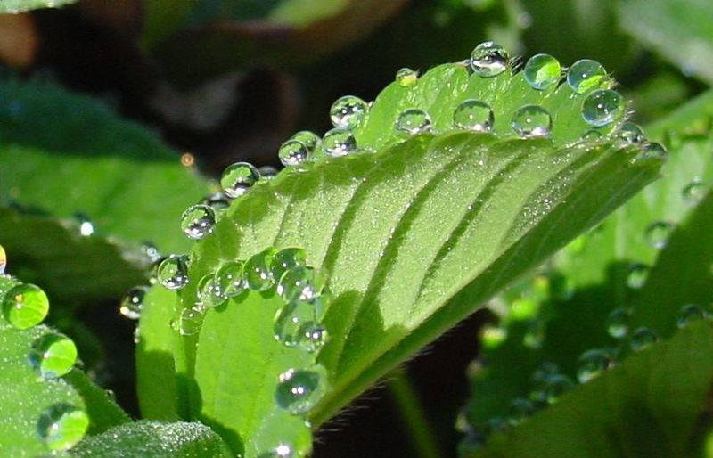
In the process of respiration, energy is produced.
Transpiration is the loss of water in vapor form from a plant.
The slow exudation of liquid water in transpiration is called guttation.

Slide 38
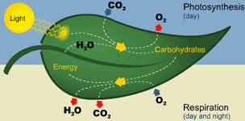
The atmosphere supplies the carbon dioxide needed for photosynthesis and the oxygen needed for respiration for a plant.

Slide 39
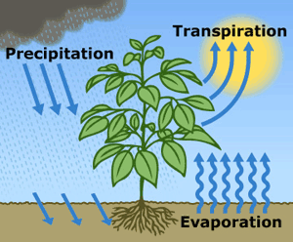
Transpiration rates are accelerated by increased temperatures or light.
Transpiration is essentially evaporation of water from plant leaves.
Notes:
If there is so little water in the soil that the plant cannot replace the water vapor it has lost even after transpiration slows, its permanent wilting.

Slide 40
Permanent Wilting vs Temporary Wilting
If there is so little water in the soil that the plant cannot replace the water vapor it has lost even after transpiration slows, its permanent wilting.
As long as there is water in the soil the wilted plant will recover as soon as the rate of transportation slows, its temporary wilting.

Slide 41
Translocation is the movement of organic materials from one part of the plant to another part.

Slide 42
The growth potential of a plant is determined by its genetic heritage and the environment in which it develops.
A plants genetic heritage is predetermined; there is nothing a grower can do to change it.
Its environment, on the other hand, is under the grower’s control to some extent.
A plants environment exists both above and below ground.

Slide 43
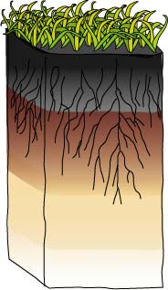
The soil is the environment of the root zone.
1.
2.
When soil is less than ideal for optimum plant growth, it is usually the result of a deficiency of essential elements, poor aeration, and improper drainage.
Notes:
It provides the mineral elements needed by plants for use during photosynthesis.
It also collects and supplies water for uptake by the plants.

Slide 44
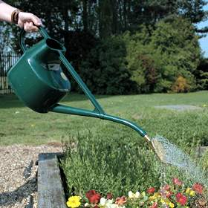
Water is essential to all life.
Light is the energy that permits all life on earth to exist.
Without light, the green color of a plant quickly fades and the plant dies.

Slide 45
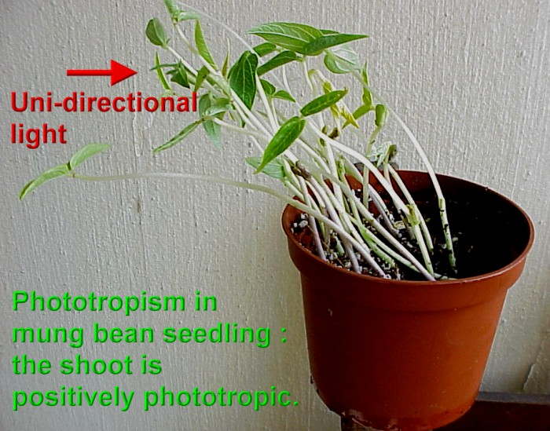
Phototropism is the term used to describe when a plant is growing toward a window.
The effect of varying periods or durations of light exposure on plant growth and development is called photoperiodism.
Notes:
It grows toward the light, uni-directional light.

Slide 46
Light
Plants need the colors blue and red to activate chlorophyll.
Light bulbs are deficient in the color blue.
Fluorescent tubes are deficient in the color red.

Slide 47
Light
Special grow lights are made that carry the correct blue and red wavelengths.
Light intensity is measured in foot candles.
Foot Candle: The amount of light given off by a candle a foot away.

Slide 48
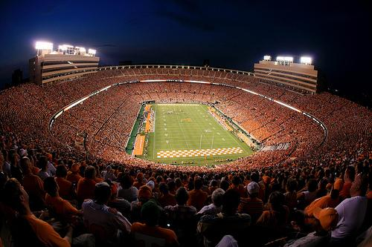
Football Field Light Foot Candles
143 foot candles (143 initial)
100 foot candles (targets)

Slide 49
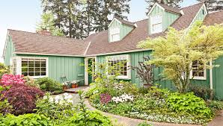
Light
Plants have adapted to survive in either high, partial, or low light intensities.

Slide 50
Light
Photoperiod: The length of daylight.
Short Day Plants: Plants that begin to flower when the nights are over 12 hours long.
Long Day Plants: Begin to flower when the nights are under 12 hours long.
Neutral Plants: Flowering response is unaffected by day length.

Slide 51
Temperature
Hardiness: A plants ability to withstand cold temperatures.
Hardiness is measured using the USDA hardiness Zone Map.
We are in Zone 6B

Slide 52
Hardiness Zone
http://planthardiness.ars.usda.gov/phzmweb/Images/All_states_halfzones_poster_300dpi.jpg

Slide 53
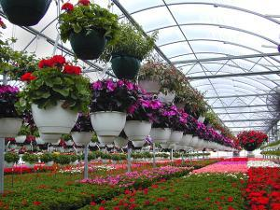
Four process influenced by temperature:
Germination
Transpiration
Respiration
Flowering
Notes:
Germination: is the process by which a plant grows from a seed
Transpiration:
is the process by which moisture is carried through plants from roots to small pores on the underside of leaves, where it changes to vapor and is released to the atmosphere.
Respiration: a process in living organisms involving the production of energy, typically with the intake of oxygen and the release of carbon dioxide from the oxidation of complex organic substances.
Origin
Flowering: the part of a seed plant comprising the reproductive organs and their envelopes if any, especially when such envelopes are more or less conspicuous in form and color

