Slide 1
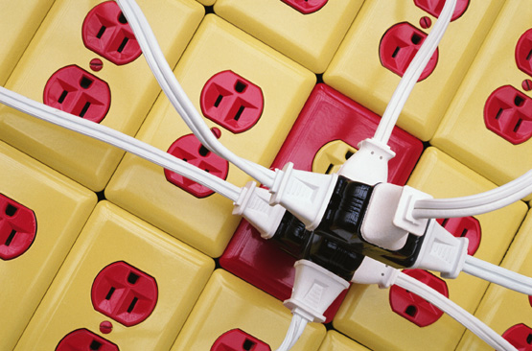
School Safety Training
Basic Electrical Safety
WAC 296-800-280
Notes:
I. Background for the Trainer:
This training session is intended to educate the average worker (i.e., machine operators, construction workers, etc.) about electrical hazards and how to inspect for them. This training will not discuss electrical safety for employees who are actually repairing electrical equipment.
Additional lockout and tagout training will be required for those employees who are “authorized” to use the lockout/tagout system.
II. Speaker’s Notes:
In this training session we will discuss how to work safely with electricity. We will focus on specific electrical hazards in our workplace and how to protect ourselves from those hazards.
This session will focus on:
How electricity works
How it impacts the human body
How to work safely with electrical equipment
Electrical hazards at our workplace

Slide 2
State Standards
Identify different methods by which electrical energy can be produced. Discuss the safety hazards involved in each method as well as prevention and control methods relevant to electrical power supplies. Justify the use of different precautions for the prevention or
management of electrical hazards and evaluate the efficacy of the prevention measures.
Utilize the appropriate instruments needed to calculate and measure voltage, amperage,
resistance, and wattage.

Slide 3

Concerned About Electricity?
How many sets of holiday
lights do you plug into one
extension cord?
Do you still use your hot
and sparking electric drill?
Is your vacuum cleaner’s
cord twisted and frayed?
Have you installed outlet
covers to protect small children’s probing fingers?
Notes:
I. Speaker’s Notes:
We use electricity every day, so we often take it for granted. We don’t consider the serious consequences that could result if we don’t take the proper precautions.
How many times have you blown a fuse or tripped a circuit breaker because you overloaded the system?
Do you inspect your electrical equipment at home?
Do you unplug electrical appliances, such as toasters, when they are not being used?
Have you taught your children about the dangers of electricity?
These are the basic electrical safety prevention methods we often take for granted.

Slide 4
Electrical Safety Goals
Electricity and the human body
Electrical hazards and safe work practices
Quiz
Notes:
I. Speaker’s Notes:
In this session we will discuss the basics of electricity and how electricity impacts the human body.
Then we will discuss electrical hazards and the proper way to work safely with electrical equipment.

Slide 5
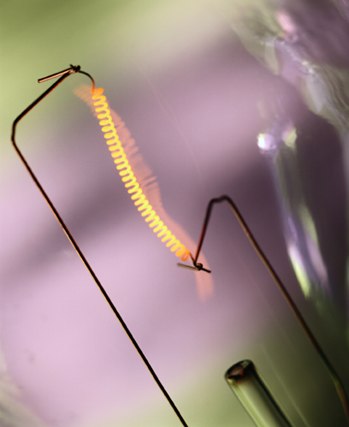
Electrical Circuits
Electrical source
Electrical user
Wires
Notes:
I. Speaker’s Notes:
A basic completed electrical circuit requires three things to function correctly:
The first is the electrical source. This can range from a battery to the transformer outside of our building that converts the high voltage carried by power lines into a lower voltage that can be used by our machinery.
The electrical user is anything that uses electricity to operate, which can range from a lightbulb to a sophisticated machine. The electrical user is what provides the significant resistance in the circuit.
The wires connect the electrical source with the electrical user. The wires are also important in that they must be rated properly for the circuit. If a wire operates with too much electricity, it may become overheated and fail. This could result in an electrical fire.

Slide 6
Rules of Electricity
Electricity travels in a completed circuit
Electricity always travels in the path of
least resistance
Electricity tries to travel to ground
Notes:
I. Speaker’s Notes:
Electricity will travel only in a completed circuit. When you flip a light switch off, you are breaking the circuit. To turn the light back on, you complete the circuit by flipping the switch on.
Electricity will always travel in the path of least resistance. Every electrical user has a certain amount of electrical resistance. If the electrical circuit has a choice between a lightbulb or a power tool, it will enlighten the bulb because it has less resistance than a power tool.
Short circuits occur because of the rule that electricity will always travel in the path of least resistance. If given the opportunity, electricity will bypass a piece of machinery (resistance). This will result in the machine not operating correctly and the circuit possibly overheating. It was designed with a certain amount of resistance, and when that resistance is bypassed, the wiring may become overheated. Circuit breakers were developed to break the circuit and stop the the flow of electricity if the source of resistance were bypassed to prevent the circuit from overheating.
Electricity will always try to travel to ground. Ground completes a circuit and offers very little resistance.

Slide 7
Electricity and People
A person usually offers a lesser resistance
for the electricity
The person forms a completed circuit when touching the ground
Electricity always tries to travel to ground
Notes:
I. Speaker’s Notes:
Electricity will travel through a person because most often that person offers less resistance than the electrical user (i.e., machinery, power tool) that is currently on the circuit.
If the person is touching the ground, that person will form a completed electrical circuit. Now the electricity will prefer to travel through the person (less resistance) and to the ground.
How can birds safely sit on high-voltage electrical wires? Because they are not touching the ground, they do not form a completed circuit, so the electricity does not pass through them.

Slide 8
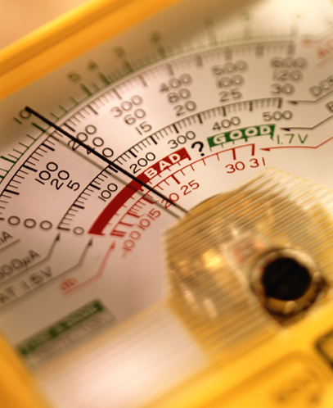
Voltages and Amperes
Voltage = Amps X Ohms
(resistance)
Converting voltage to amps
Typical Industrial Voltages
  110/120 Volts = 60
  milliAmps (mA)
  220/240 Volts = 120 mA
  440/480 Volts = 240 mA
Notes:
I. Background for the Trainer:
So that you understand where the mA numbers come from, we will go through the formula. Voltage = Amps X Ohms. Let’s look at the 120-volt circuit and assume a body has 2,000 ohms of resistance.
120 = Amps X 2,000 or Amps = 120/2,000 = 0.06
Since 1,000 milliAmps = 1 Amp, then 0.06 Amps = 60 mA
II. Speaker’s Notes:
Now it’s time for some basic electrical math. Understanding this formula is really important only for employees who repair and troubleshoot electrical equipment; however, the formula can help you understand how electricity can be dangerous.
On a given circuit, voltage is consistent. What changes is the resistance, which in turn changes the amps. Amps are what we need to be concerned with, as you will soon see. According to the formula: as the resistance goes up, the amps will decrease, and if the resistance goes down, the amps will increase.
Everyone’s body is different, but let’s just assume an average resistance for this example.
As you can see, the same resistance on different voltage circuits will result in different amps. When the voltage increases, so do the amps.
Notice the number of mA an average person can be exposed to with the typical home voltage of 110/120: 60 mA. Remember this number for the next slide.

Slide 9
Effects on the Human Body
1 mA: Can be felt by the body
2-10 mA: Minor shock, might result in a fall
10-25 mA: Loss of muscle control, may
not be able to let go of the current
25-75 mA: Painful, may lead to collapse
or death
75-300 mA: Last for 1/4 second, almost always immediately fatal
Notes:
I. Speaker’s Notes:
Even one milliAmp (mA) can be felt by the human body.
2-10 mA can result in a minor shock. What if this person was working on an elevated platform without proper fall protection? This minor shock could cause the person to fall from the elevation and be seriously injured or killed.
At 10-25 mA the person may lose muscle control and may not be able to release or let go of the circuit. This situation is especially dangerous if there are no other employees in the area who can break the circuit by removing the person from the equipment. (Remember, never touch people who are being shocked; use a piece of non-conducting wood to pry them away from the electrical current.)
25-75 mA is painful and may lead to collapse or even death. The longer the person is exposed to this electrical current, the more likely death will occur.
75-300 mA for even a quarter of a second almost always is immediately fatal. This is because of ventricular fibrillation (twitching heart).
Now, remember how many milliAmps an average person could be exposed to at home: 60 mA. Even the seemingly low voltage of a home can be extremely hazardous to a person. What about a child that has less resistance - their mA exposure will be much higher on that same 110/120 voltage circuit.

Slide 10
Body’s Resistance
Skin offers most of the body’s
electrical resistance
Increased resistance
  Thick and callused skin (foot or hand)
  Dry skin
Decreased resistance
  Thin skin (inner forearm)
  Wet or sweaty skin
  Broken or abraded skin (scratches)
Notes:
I. Speaker’s Notes:
Because the skin offers most of the body’s electrical resistance, the point of electrical contact with the skin will determine the amount of shock received. Remember, the higher resistance - the less mA of exposure, which means a lower amount of the shock.
Resistance is increased if you are shocked in an area that has thick or callused skin or if your skin is dry.
Your resistance decreases (thus increasing your shock, also known as mA) if the electricity contacts you in an area of thin skin, your skin is wet or sweaty, or if the skin is broken.

Slide 11
Resistance Varies
Different levels of electrical resistance
for each person
Ranges from 500 ohms to many thousands
of ohms
The greater the body’s resistance, the less chance of harm
A similar voltage shock can be minor to
one person and deadly to another
Notes:
I. Speaker’s Notes:
Because every human body is built differently, every one will have a different level of resistance.
The range can be from as little as 500 ohms to many thousands of ohms.
As we’ve already discussed, the greater your body’s resistance, the less amps you will receive, and thus the less chance you will be harmed by a shock.
This is why a similar voltage shock can feel minor to one person and be deadly to another. Of course, there are other considerations. A person might have a heart that is more sensitive to ventricular fibrillation than another person’s heart.

Slide 12
Additional Resistance
Gloves
Shoes
Mats
Notes:
I. Background for the Trainer:
Only employees authorized to repair and troubleshoot electrical equipment would need to wear PPE. All other employees will not be subject to electrical exposure because they will not be repairing electrical equipment.
Employees who are exposed to static electricity might need to use PPE to reduce their exposure to static electricity.
II. Speaker’s Notes:
The primary way to protect yourself from electrical hazards is by using PPE that increases the resistance offered by the body (thus decreasing the number of mA you’re exposed to).
Of course, you will want to make sure the PPE being used is properly rated for the voltage that you might be exposed to.
Gloves provide increased resistance at the most likely point of electrical contact.
Shoes and mats increase resistance by making it more difficult for the current to reach the ground.

Slide 13
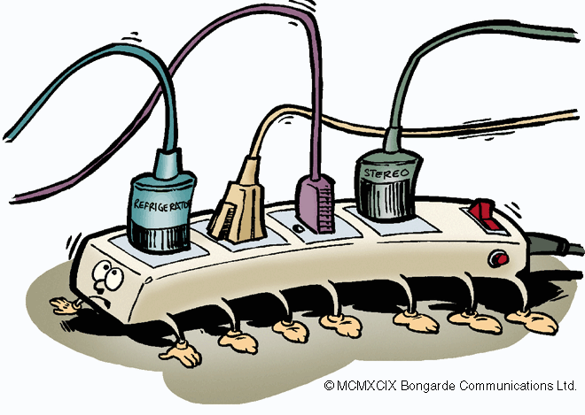
Electrical Safety Goals
Electricity and the human body
Electrical hazards and safe work practices
Quiz
Notes:
I. Speaker’s Notes:
Are there any questions on the basics of electricity and how it can impact the
human body?
Let’s discuss potential electrical hazards and safe work practices.

Slide 14
Training
Qualified workers
  How to identify exposed energized parts
  How to safeguard or work on energized parts
  Have received LO/TO training
Unqualified workers
  How electricity works
  Risks of working with energized equipment
  Tasks to be performed only by qualified workers
Notes:
I. Speaker’s Notes:
WISHA has divided workers into two categories when it comes to working on or with electrical equipment.
Qualified workers are allowed to work on or near exposed energized equipment. They receive additional detailed training that includes:
How to identify exposed electrical equipment and energized parts;
How to lock out or tag out equipment so that it can be worked on safely (Additional LO/TO training is required);
How to safely work on or troubleshoot electrical equipment and parts.
Unqualified workers are not permitted to work on or near exposed energized equipment. They receive the training that has been discussed in this session, which includes:
How electricity works;
How electricity can contact and harm the human body;
Which tasks require a qualified worker to perform;
How to identify potential electrical hazards and how to use equipment and machinery that is powered by electricity.

Slide 15
Hazard Control
Electrical systems are inherently safe
Injuries typically occur when:
  Procedures are inappropriate
  Procedures are not followed or ignored
  Safety systems are circumvented
Notes:
I. Speaker’s Notes:
Electrical systems, when designed and built properly, are the safest form of energy. Electrical systems are inherently safe.
Injuries typically occur when improper procedures are used to work on electrical equipment, the hazards of electrical systems are not understood or not taken seriously, or when safety systems are ignored or circumvented.
This is why it is so important for workers to identify and understand the hazards
of electricity, inspect equipment before they use it, and use the equipment correctly.

Slide 16
General Electrical Hazards
High-voltage overhead
power lines
Damaged insulation on wires
Digging or trenching near
buried lines
Broken switches or plugs
Overloaded circuits
Overheated appliances or tools
Static electricity
Flammable materials
Notes:
I. Speaker’s Notes:
We will discuss most of these points in further detail on the next few slides.
Always stay at least 10 feet away from high-voltage power lines. High-voltage lines are bare conductors, so contacting them with a ladder, cherry picker, manlift bucket truck, etc., will cause electrical shocks. If a dump truck were to touch high-voltage power lines when it raised its bed to unload the contents, the driver would not even feel the electricity because the large rubber tires would prevent the voltage from reaching the ground and forming a completed circuit (much like the birds sitting on a wire). However, if the driver were to step out of the truck, he would be electrocuted as soon as his foot touched the ground.
Damaged wiring insulation exposes hot wires to potentially combustible materials and may start a fire.
Always contact your local utility companies prior to doing any digging or trenching and have them mark the locations of their wires.
Broken switches or plugs can cause overheating in the circuit.
Overloaded circuits are created when too much electrical current is running through a given electrical system.
Appliances or tools can become overheated if they have an internal electrical problem.
Static electricity can cause discomfort for workers or even start a fire or explosion when around flammable materials.
Make sure flammable materials are properly stored and grounded, especially when chemicals are being dispensed.

Slide 17
Portable Power Tools
Inspect portable power tools
Never use damaged equipment
  Tag it out of service
  Have it repaired or replaced
Never use portable power equipment in wet or damp areas
Stop using power tools if they become hot or start sparking
Notes:
I. Background for the Trainer::
Bring a portable power tool to the class so that you can point out the different hazards to the employees.
II. Speaker’s Notes:
Portable power tools are used by almost everyone either at work or at home. They need to be taken care of and properly inspected because they can have many of the potential hazards listed on the previous slide such as:
Damaged wire insulation
Broken plugs
Overloaded circuits (i.e., pop a fuse when turned on)
Overheated or sparked
If you find that a power tool is damaged, tag it out of service and have it repaired or replaced.
Using portable power tools in a wet or damp area is just asking for the electricity to go to ground and shock you.
If a power tool appears to be getting too hot or starts sparking, stop using it, tag it out of service, and have it repaired or replaced.

Slide 18

Extension Cords
Inspect and check for capacity
For temporary work only
Do not use as a rope to pull or lift objects
Should not be fastened with staples or hung over metal hooks or nails
Notes:
I. Background for the Trainer:
Bring an extension cord to the class so that you can show them how to properly inspect the cord and what hazards to look for.
II. Speaker’s Notes:
Extension cords can also have some of the general hazards listed in the earlier slide, so they should always be inspected before use.
Also make sure the cord is rated for the load you plan to put on it. Can that extension cord handle the 15 strings of holiday lights and the illuminated snowman with the waving arm? Is the extension cord rated for outdoor use? If not, the cord could become overheated, start a fire, or blow a circuit breaker in your home, classroom or school.
Extension cords are designed for temporary work. They are not intended to be used as a permanent power source because they are more likely to be damaged or overloaded, and they are not supplied with their own circuit breaker as a hardwired system would be.
Extension cords are not ropes. They can easily be stretched and damaged if used to hoist objects.
Do not use staples or nails to hang extension cords because this could cause damage to the outer jacket of insulation. If the wire were to become exposed, the current could reach ground through the nail or staple and cause a short-circuited and hot cord.

Slide 19
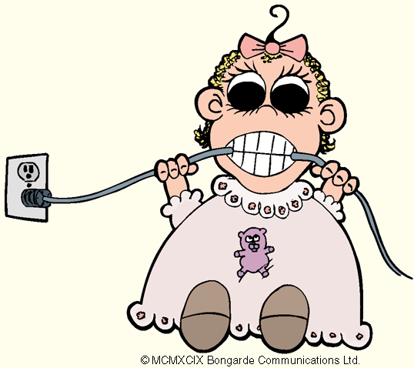
Electrical Cord Inspection
Deformed or missing pins
Damaged outer jacket or insulation
Evidence of internal damage
If damaged, take out of service until repaired
Notes:
I. Speaker’s Notes:
Inspect the plugs for deformed or missing pins. Don’t yank an electrical cord out of the socket by pulling on the cord. Remove the cord by pulling on the plug.
Inspect the outer jacket or insulation of the cord for cuts, abrasions, or signs of wear.
Is there evidence of internal damage such as a pinched or crushed outer jacket?
If a cord is damaged, tag it out of service and repair or discard it.

Slide 20
Circuit Protection
Energize or de-energize with appropriate switches, breakers, etc.
Do not energize or de-energize with fuses, terminal lugs, or cable splice connections
If circuit protection device is tripped—inspect
Notes:
I. Speaker’s Notes:
Circuits are protected with equipment such as breakers or fuses. These allow a certain amount of amperage in the circuit before blowing, tripping, or otherwise breaking the circuit. They are used to protect equipment and wiring in the system from being damaged by too much electrical current.
Energize (close the circuit) or de-energize (open the circuit) with the appropriate equipment such as switches or breakers.
Do not open or close circuits by installing and removing fuses, taking terminal lugs off and on, or by splicing cables.
If a circuit protection device is tripped, have an authorized worker inspect the system before manually re-energizing the circuit. There may be a short or some other electrical hazard that needs to be repaired.

Slide 21
Grounding Equipment
Most electrical equipment is designed with a grounding system
Do not use equipment with damaged grounding connectors
Do not use adapters that interrupt the grounding connection
NEVER cut the ground leg (third prong) off of a plug. It is there to protect you!
Notes:
I. Speaker’s Notes:
Almost all electrical equipment is designed with some sort of grounding system so that if there is a problem such as a short circuit, the electrical current will go to ground through the grounding system rather than through the human body.
Do not use equipment with damaged grounding connectors. Some people might alter a 3-prong plug by cutting off the grounding prong so that they can plug into a 2-prong receptacle. This practice is not safe because you are bypassing an equipment safeguard and setting yourself up for an injury.
Another option is to use an adapter that converts a 3-prong system into a 2-prong system. Again, this interrupts the grounding connection. The adapters are not designed to send the current to ground if there is a problem.

Slide 22
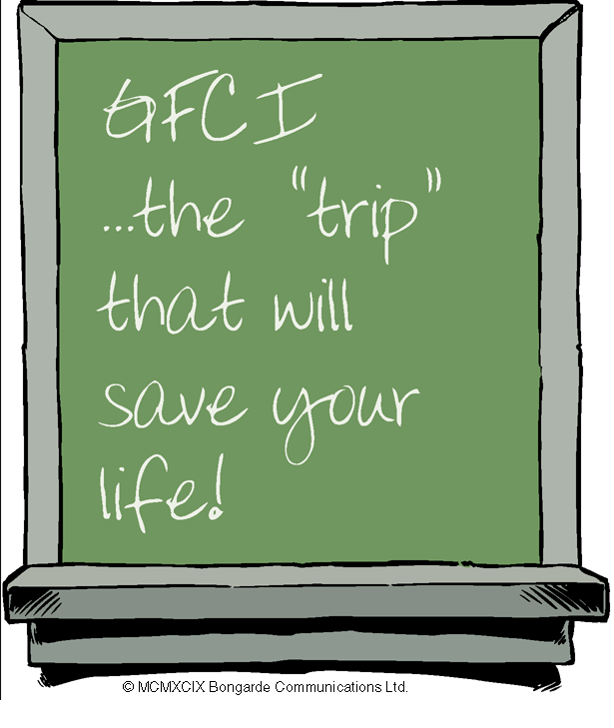
Ground Fault Circuit Interrupters
GFCIs reduce the likelihood of fatal shocks
Detect small amount of earth current and automatically switch off the power
Used with extension cords and portable tools
Fuses and circuit breakers protect equipment, not people
Notes:
I. Background for the Trainer::
If your school district uses Ground Fault Circuit Interuptors (GFCIs), bring one in to demonstrate to the employees.
II. Speaker’s Notes:
GFCIs reduce the likelihood of fatal shocks by automatically switching off the power when a small amount of earth or grounded current is detected.
GFCI receptacles are found in schools or hotels in the bathroom or kitchen where an electric appliance such as a hair dryer or toaster has a chance to fall into a sink full of water. If this occurred, the GFCI would automatically shut off the power to the receptacle. The receptacle would have to be manually reset.
GFCIs can also be portable and used with extension cords and power tools.
Fuses and circuit breakers operate at several Amps to allow the circuit to continue even when slightly overloaded. Remember, people are injured at the milliAmp level.

Slide 23
Static Electricity
Created when materials rub together
Can cause shocks or even minor skin burns
Reduced or prevented by:
  Proper grounding
  Rubber matting
  Grounding wires, gloves, or shoes
Notes:
I. Speaker’s Notes:
Static electricity is very common in schools and at home. It is caused when two materials rub against each another and build up a charge of electricity. The static is finally dissipated when a grounded conductor, such as a doorknob, is touched.
Sometimes static electricity can result in arcs of electricity leaping from a person onto an worker’s metal tools or workbench. This type of static electricity can cause minor skin burns. It can cause dangerous shocks for people with heart conditions.
Static electricity can be reduced by properly grounding the equipment, providing rubber matting (i.e., increased resistance) for the worker to stand on, or providing PPE such as grounding wires that connect to a worker’s wrist, gloves, or shoes.
You may have noticed computer technicians using a wrist strap to ground them to the computer. This will prevent damage to the computer or to the tech from static electricity.

Slide 24
Flammable/Ignitable Materials
Flammable gases, vapors, or liquids
Combustible dust
Can be ignited by static electricity
Require specially designed electrical equipment
Notes:
I. Background for the Trainer:
Show or describe how your school district stores and properly grounds flammable and combustible materials.
II. Speaker’s Notes:
Flammable and ignitable materials include flammable gases, vapors, or liquids, and combustible dusts.
All of these can be ignited by even the smallest spark of electricity. People have been killed and seriously injured by the ignition of a flammable substance by a static electricity spark. For example, when filling portable gasoline containers at the gas station, place the container on the ground (therefore properly grounding the container) before filling it. These containers have been know to explode from static electricity when left in a truck bed. The plastic container rubs on the plastic truck bed (or metal container of metal truck bed) creating static electricity that cannot reach the ground because of the truck tires.
Rooms that permanently use or store flammable substances require special explosion proof electric systems such as lighting and outlets. Do not use portable power equipment in rooms that are known to intermittently contain flammable substances.

Slide 25
Where do we find flammable liquids in school districts?
CTE (Voc-Ed) wood and metal and shops
Science labs & storerooms
Visual Arts (Arts & Crafts) classrooms
Maintenance departments
Transportation departments
Grounds keeping departments
Notes:
In school districts we find flammable liquids in various places.
Voc-Ed wood shops, e.g., flammable finishes and paint thinners, etc.
Voc Ed metal shops, e.g., solvents, cleaners, paints, etc.
Science storerooms, e.g., various chemicals
Arts and Crafts, e.g., acetone, solvents, thinners, etc.
Maintenance, e.g., paints, thinners, solvents, etc.
Transportation, e.g., gasoline, carburetor cleaner, engine cleaners, etc.
Grounds, e.g., gasoline for mowers, snow blowers, etc.
Ask the class participants to think of other places in their school or work location where there are flammable liquids, gases, dusts, etc.
Use this list to inspect these items/conditions and institute appropriate safety measures if not already done.

Slide 26
Machine Operators
Never tamper with electrical interlocks
Do not repair electrical components of
your machine
Properly shut off machinery before working
in the point of operation
Obey warning signs and follow safe procedures
Notes:
I. Speaker’s Notes:
Never tamper with or bypass electrical interlocks or other machine safeguards. You are risking injury to yourself and others every time you do this.
Do not attempt to repair electrical components of your machine. Do not even open your machine’s electrical panel. Remember, only authorized workers are permitted to repair or work on electrical equipment.
Properly disengage or shut off your machine before working in its point of operation. This may mean hitting the emergency stop or even calling an authorized worker to lock out the machine first.
Obey warning signs and stickers, particularly those that warn of high voltage.
Are warning signs in place everywhere they are needed in your school district?
Learn to identify electrical malfunctions of your machine.

Slide 27
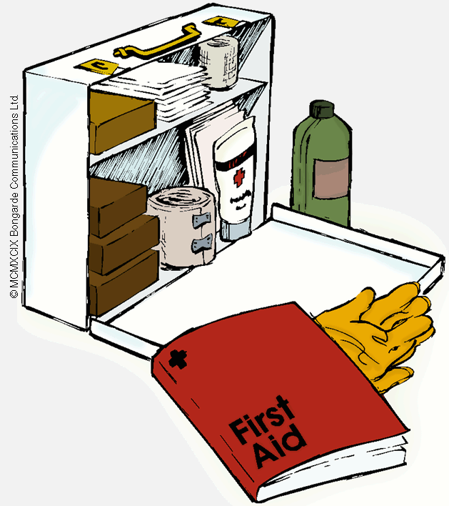
Electrical Safety Goals
Electricity and the human body
Electrical hazards and safe work practices
Quiz
Notes:
I. Speaker’s Notes:
Any questions concerning the hazards of electricity and how to work safely with it?
Let’s wrap up the training session and see what you’ve learned.

Slide 28
Summary
Electricity will try to reach ground even if it means going through a person
Even the “small” voltage from your home can cause serious injury
Always inspect power tools and cords and do not use them if damaged
Do not attempt to repair electrical equipment unless trained and qualified
Notes:
I. Speaker’s Notes:
This slide lists the main points to remember when working with electricity.
Remind your class that this is only a very basic electrical safety presentation.
Remind them that WAC 296-800-280 is the law in Washington State.
Violations of this law can result in citations and fines as well as personal injury to yourself, your co-workers and/or our students.

Slide 29
ELECTRICAL CIRCUITS
S.MORRIS 2006
More free powerpoints at www.worldofteaching.com

Slide 30
State Standards
Identify different methods by which electrical energy can be produced. Discuss the safety hazards involved in each method as well as prevention and control methods relevant to electrical power supplies. Justify the use of different precautions for the prevention or
management of electrical hazards and evaluate the efficacy of the prevention measures.
Utilize the appropriate instruments needed to calculate and measure voltage, amperage,
resistance, and wattage.

Slide 31
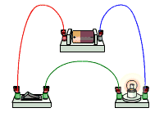
The CELL
The cell stores chemical energy and transfers it to electrical energy when a circuit is connected.
When two or more cells are connected together we call this a Battery.
The cells chemical energy is used up pushing a current round a circuit.

Slide 32
What is an electric current?
An electric current is a flow of microscopic particles called electrons flowing through wires and components.
-
+
In which direction does the current flow?
from the Negative terminal to the Positive terminal of a cell.

Slide 33
simple circuits
Here is a simple electric circuit. It has a cell, a lamp and a switch.
cell
wires
switch
lamp
To make the circuit, these components are connected together with metal connecting wires.

Slide 34
simple circuits
When the switch is closed, the lamp lights up. This is because there is a continuous path of metal for the electric current to flow around.
If there were any breaks in the circuit, the current could not flow.

Slide 35
circuit diagram
Scientists usually draw electric circuits using symbols;
cell
lamp
switch
wires

Slide 36


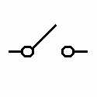


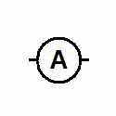
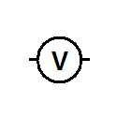
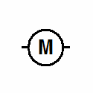

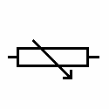
circuit diagrams
In circuit diagrams components are represented by the following symbols;
cell
battery
switch
lamp
buzzer
ammeter
voltmeter
motor
resistor
variable resistor

Slide 37
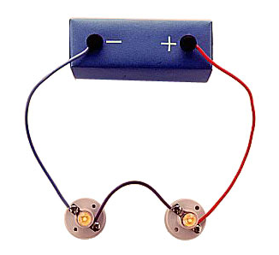
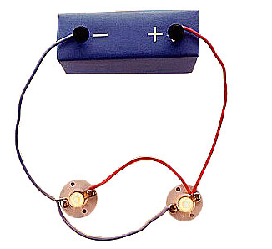
types of circuit
There are two types of electrical circuits;
SERIES CIRCUITS
PARALLEL CIRCUITS

Slide 38
SERIES CIRCUITS
The components are connected end-to-end, one after the other.
They make a simple loop for the current to flow round.
If one bulb ‘blows’ it breaks the whole circuit and all the bulbs go out.

Slide 39
PARALLEL CIRCUITS
The components are connected side by side.
The current has a choice of routes.
If one bulb ‘blows’ there is still be a complete circuit to the other bulb so it stays alight.

Slide 40
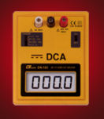
measuring current
Electric current is measured in amps (A) using an ammeter connected in series in the circuit.
A

Slide 41
measuring current
This is how we draw an ammeter in a circuit.
A
A
SERIES CIRCUIT
PARALLEL CIRCUIT

Slide 42
measuring current
SERIES CIRCUIT
current is the same
at all points in the
circuit.
2A
2A
2A
PARALLEL CIRCUIT
2A
2A
current is shared
between the
components
1A
1A

Slide 43
copy the following circuits and fill in the missing ammeter readings.
?
?
3A
3A
4A
?
1A
?
4A
4A
1A
?
1A

Slide 44

measuring voltage
The ‘electrical push’ which the cell gives to the current is called the voltage. It is measured in volts (V) on a voltmeter
V

Slide 45
measuring voltage
Different cells produce different voltages. The bigger the voltage supplied by the cell, the bigger the current.
Unlike an ammeter a voltmeter is connected across the components
Scientist usually use the term Potential Difference (pd) when they talk about voltage.

Slide 46
measuring voltage
This is how we draw a voltmeter in a circuit.
V
V
SERIES CIRCUIT
PARALLEL CIRCUIT

Slide 47
measuring voltage
V
V
V
V

Slide 48
series circuit
voltage is shared between the components
3V
1.5V
1.5V

Slide 49
parallel circuit
voltage is the same in all parts of the circuit.
3V
3V
3V

Slide 50
measuring current & voltage
copy the following circuits on the next two slides.
complete the missing current and voltage readings.
remember the rules for current and voltage in series and parallel circuits.

Slide 51
measuring current & voltage
a)
6V
4A
A
V
V
A

Slide 52
measuring current & voltage
b)
6V
4A
A
V
A
V
A

Slide 53
answers
a)
b)
6V
6V
4A
4A
6V
4A
4A
3V
3V
2A
4A
6V
2A

