Slide 1
Greenhouse Plant ID #1

Slide 2
Amazon Lilies
Temperature: minimum 70 degrees
Light: At least 8 hours in partial shade
Perennial Plant
Soil Moisture: keep the soil moist, allowing the surface to dry to the touch between watering's

Slide 3
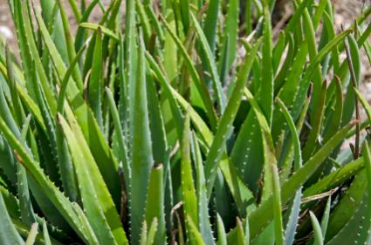
Aloe Vera
Temperature: 50 degrees
Light: Full Sun and Light Shade
Perennial
Soil: Does not tolerate very wet soil, requires soil great drainage

Slide 4
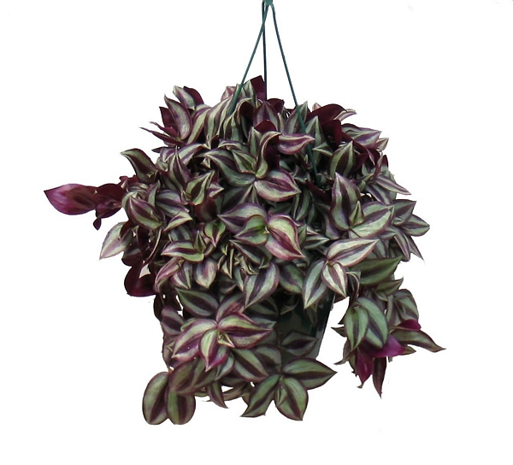
Wandering Jew
Temperature: Minimum 50 degrees
Light: Bright & Indirect
Soil: should be kept evenly moist when plant is actively growing, allow soil to completely dry before watering during dormant cycle
Perennial

Slide 5
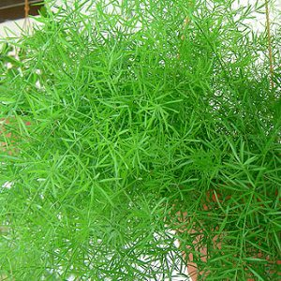
Asparagus Fern
Temperature: minimum 60 at night –75 during the day
Light: light to heavy shade
Soil: do not let soil get completely dry
Perennial

Slide 6
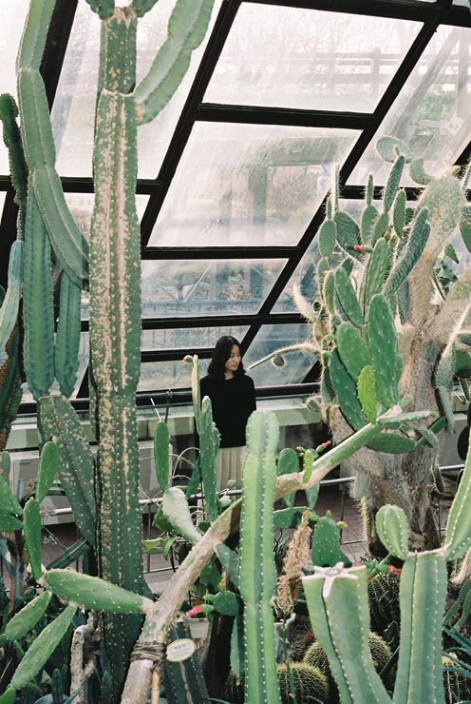
Cacti
Light: High light, direct sun
Temperature: 40-65 degrees
Soil: Water thoroughly and wait until the soil surface is dry before watering again. Almost no water in winter
Perennials

